Slide 1
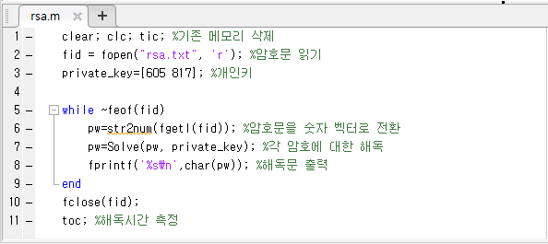
rsa.m

Slide 2
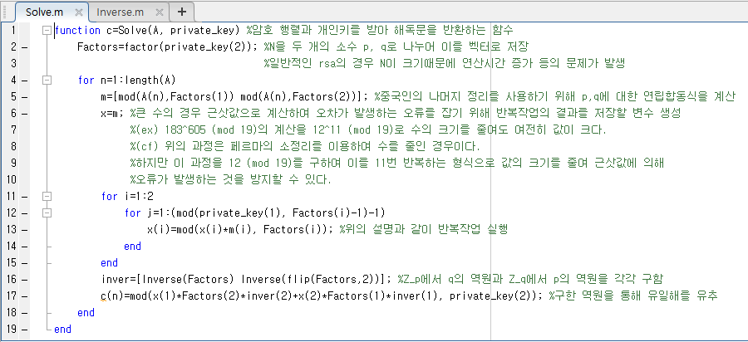
Solve.m

Slide 3
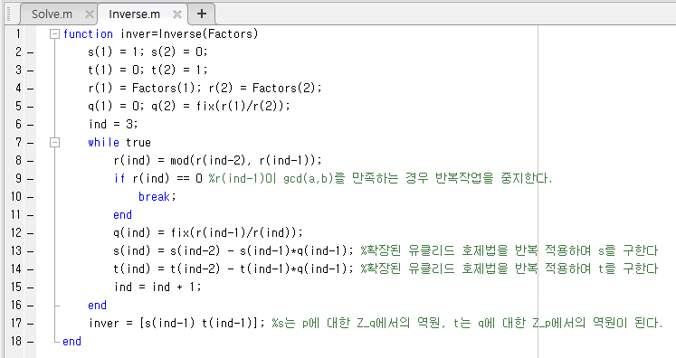
Inverse.m

Slide 4
Solve.m

